Slide 1
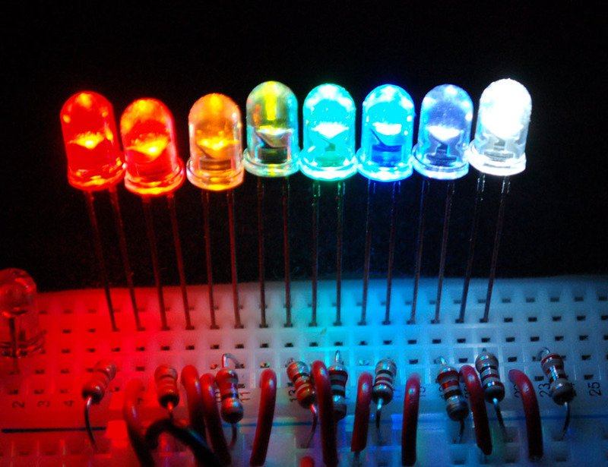
Light Emitting Diode

Slide 2
A light-emitting diode (LED) is a semiconductor light source that emits light when current flows through it
Electrons in the semiconductor recombine with electron holes, releasing energy in the form of photons

Slide 3
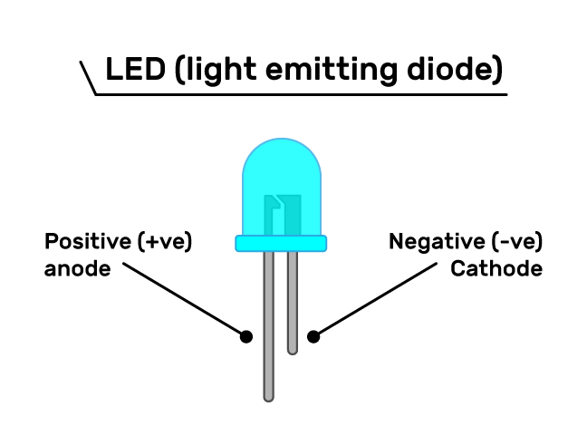

Slide 4
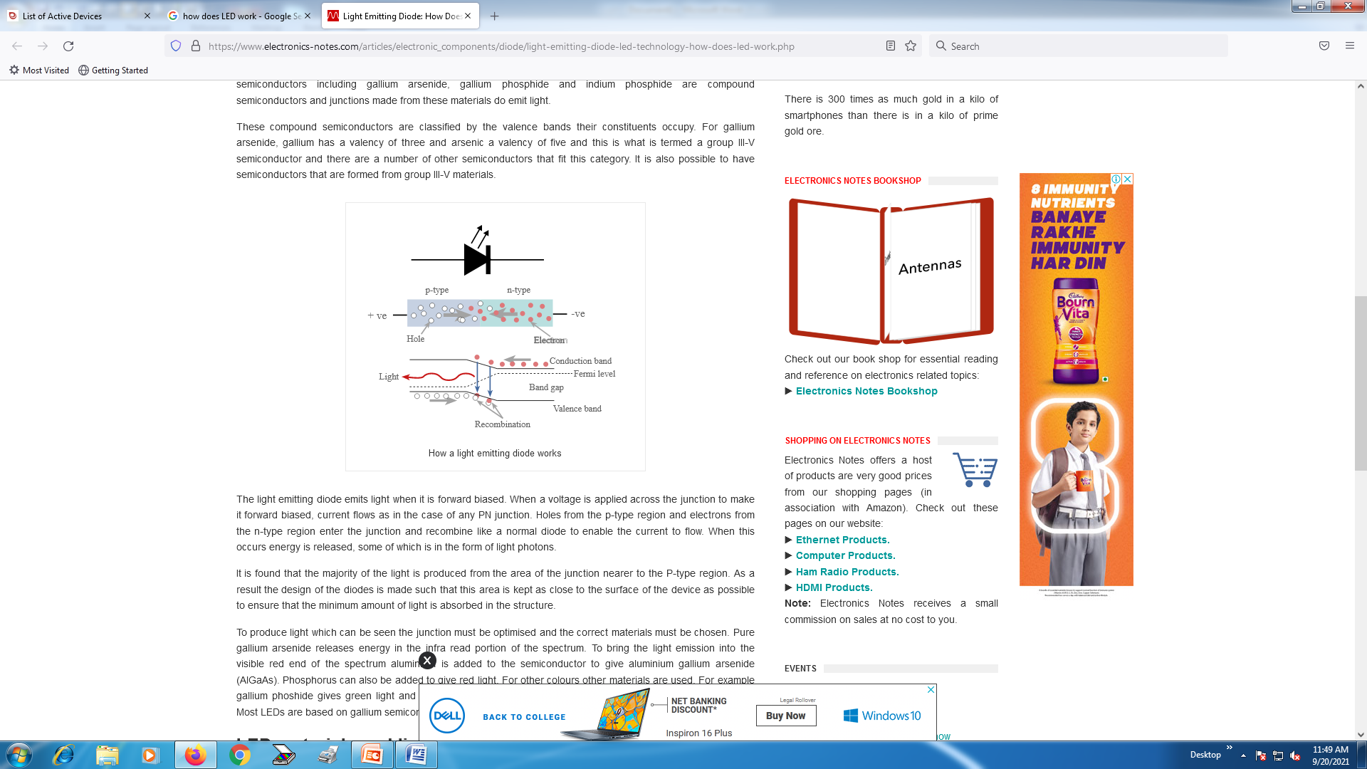
Working of LED

Slide 5
The LED is a specialised form of PN junction that uses a compound junction.
Compound semiconductors including gallium arsenide, gallium phosphide and indium phosphide and junctions made from these materials do emit light.

Slide 6
The light emitting diode emits light when it is forward biased
When a voltage is applied across the junction to make it forward biased, current flows as in the case of any PN junction.
Holes from the p-type region and electrons from the n-type region enter the junction and recombine like a normal diode to enable the current to flow

Slide 7
When this occurs energy is released, some of which is in the form of light photons.
Modern LEDs are available in visible, ultraviolet (UV), and infrared wavelengths, with high, low, or intermediate light output.

Slide 8
Early LEDs were often used as indicator lamps, replacing small incandescent bulbs, and in seven-segment displays.
Recent developments have produced high-output white light LEDs suitable for room and outdoor area lighting.

Slide 9
LEDs are used in applications as diverse as aviation lighting, fairy lights, automotive headlamps, advertising, general lighting, traffic signals, camera flashes, lighted wallpaper, horticultural grow lights, and medical devices

Slide 10
Advantages of using LEDs over incandescent light sources
lower power consumption,
longer lifetime,
improved physical robustness,
smaller size,
and faster switching

Slide 11
Disadvantages of LEDs
electrical limitations to low voltage and generally to DC (not AC) power,
inability to provide steady illumination from a pulsing DC or an AC electrical supply source,
and lesser maximum operating temperature and storage temperature.
(In contrast to LEDs, incandescent lamps can be made to intrinsically run at virtually any supply voltage, can utilize either AC or DC current interchangeably, and will provide steady illumination (due to thermal inertia) when powered by AC or pulsing DC even at a frequency as low as 50 Hz.
LEDs usually need electronic support components to function, while an incandescent bulb can and usually does operate directly from an unregulated DC or AC power source.

Slide 12
Contd….
The fast switching of LEDs is unfavorable when a steady, unfluctuating source of light is desired, but it can be overcome by providing to them a very steady regulated DC electrical supply, at the expense of high-quality DC regulator electronics.)
As in nearly all engineering matters, whether the advantages or disadvantages of LEDs are more significant depends on the application.

Slide 13
Advantages
For some applications, such as high-speed data signalling (as in IR remote controls and fiber-optic communications) or information display or indication in small battery-powered devices, LEDs are nearly ideal while incandescent lamps are completely inadequate.
LEDs are much more energy-efficient and long-lasting

Slide 14
Efficiency: LEDs emit more lumens per watt than incandescent light bulbs.The efficiency of LED lighting fixtures is not affected by shape and size, unlike fluorescent light bulbs or tubes.
Color: LEDs can emit light of an intended color without using any color filters
Size: LEDs can be very small (smaller than 2 mm²) and are easily attached to printed circuit boards

Slide 15
Warmup time: LEDs light up very quickly.
Cycling: LEDs are ideal for uses subject to frequent on-off cycling,
Dimming: LEDs can very easily be dimmed either by pulse-width modulation or lowering the forward current
Cool light: In contrast to most light sources, LEDs radiate very little heat in the form of IR that can cause damage to sensitive objects or fabrics.

Slide 16
Lifetime: LEDs can have a relatively long useful life. Approx. 35,000 to 50,000 hours of useful life.
Shock resistance: LEDs, being solid-state components, are difficult to damage with external shock,
Focus: The solid package of the LED can be designed to focus its light

Slide 17
Disadvantages
Temperature dependence: LED performance largely depends on the ambient temperature of the operating environment – or thermal management properties
Voltage sensitivity: LEDs must be supplied with a voltage above their threshold voltage and a current below their rating

Slide 18
Color rendition: Most cool-white LEDs have spectra that differ significantly from a black body radiator like the sun or an incandescent light
Efficiency droop: The efficiency of LEDs decreases as the electric current increases. Heating also increases with higher currents, which compromises LED lifetime

Slide 19
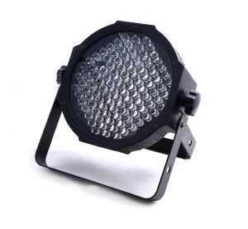
Applications
Indicators and signs (displays, message boards, traffic signals, glow sticks, emergency lighting, daytime running lights)
Lighting (flashlights, street lights, projectors)
Data communication and other signalling (navigation in closed spaces)
Machine vision systems (barcode scanners)

